Slide 1
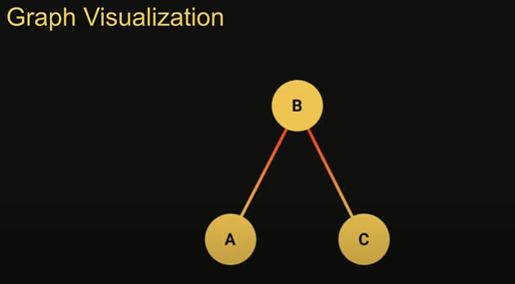
A graph is a non linear data structures that consist of finite number of vertices(also called nodes) connected by edges
Trees are a specific type of graph data structures
Types of graph –
1. Directed – A graph in which the edges have a direction Edges are usually represented by arrows pointing in the direction the graph can be traversed ex. A-B- C
2. Undirected - A graph in which the edges are bidirectional
The graph can e traversed in either direction
The absence of a arrow tells us that the graph is undirected
Graph Usage – Google Maps, Social media sites

Slide 2
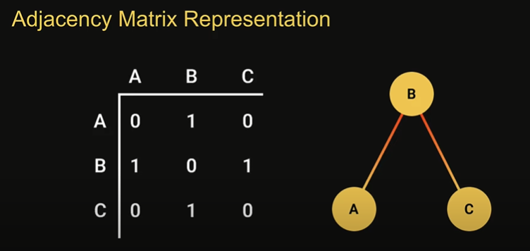
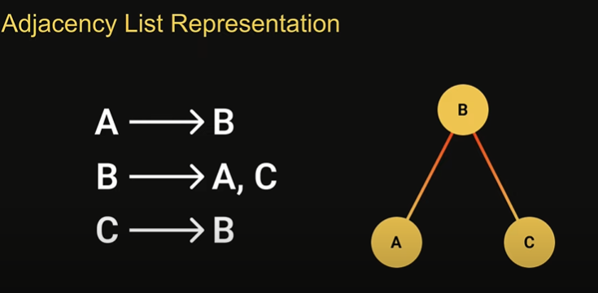
Graph Representation
Adjacency Matrix – An adjacency matrix is a 2D array of size V x V where V is the number of vertices in the graph
Each row and column represent a vertex
If the value of any element say , matric[i][j] it represents that there is an edge connecting vertex I and vertex j
Adjacency List- Vertices are sorted in a map like data structure, and every vertex stores a list of its adjacent vertices.

Slide 3
Adjacency matric vs Adjacency list
With adjacency matrix you store values irrespective of whether an edge exists or not storage wise an adjacency list is way more efficient
Adjacency matrix it is linear time complexity
Such information would have to be stored externally
With an adjacency list, w only need to store the values for the edges that exist
With adjacency list inserting and finding adjacent nodes is constant time complexity whereas
It allows you to store additional values with an edge such as weight of the edge

